Slide 1


Patterns, Language, and Documents (Part 2)
John Beverley
Assistant Professor, University at Buffalo
Co-Director, National Center for Ontological Research
Affiliate Faculty, Institute of Artificial Intelligence and Data Science

Slide 2
Outline
Real Patterns
From Language to Speech Acts
From Speech Acts to Document Acts

Slide 3
From Speech Acts to Document Acts
Documents can be:
Copied, modified, stored
Aggregated, e.g. appendices
Have component parts, e.g. plans have sub-plans
Executable, e.g. code
Documents, combined with authority, make possible collective agency in corporations, universities, religions, governments, legal codes, armies, etc.

Slide 4
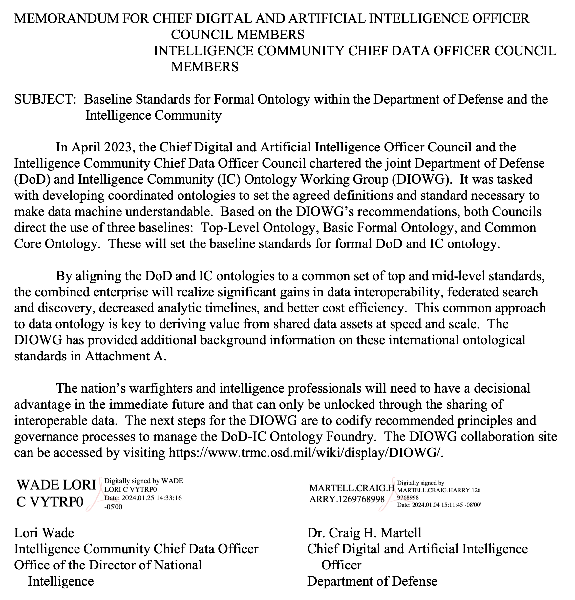
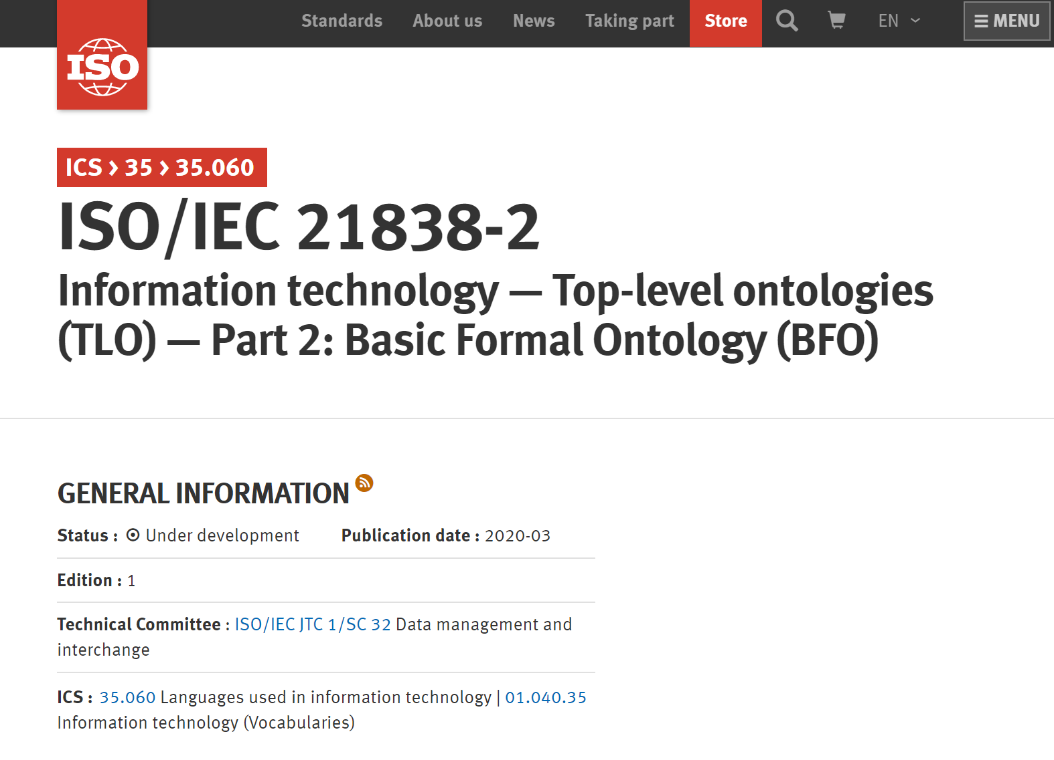

Slide 5
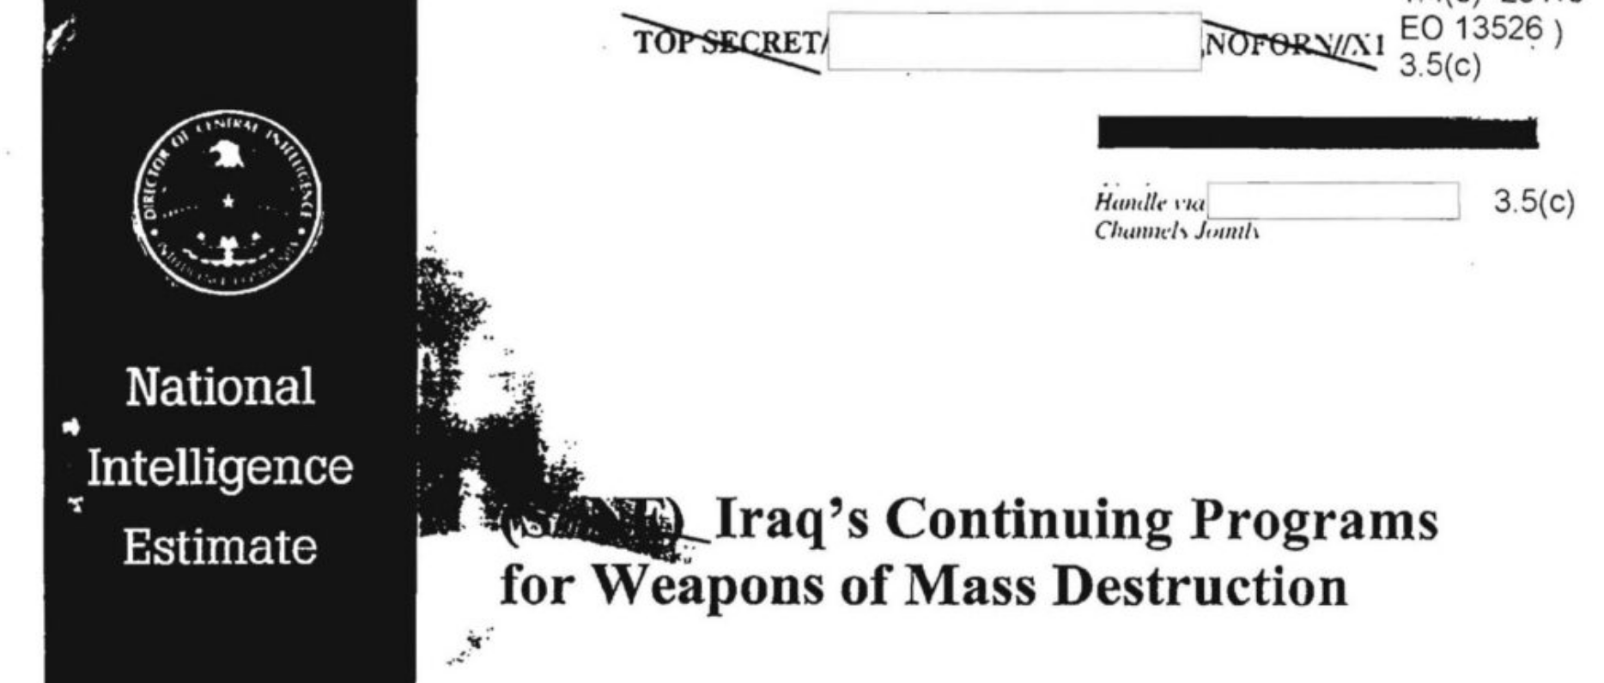

Slide 6
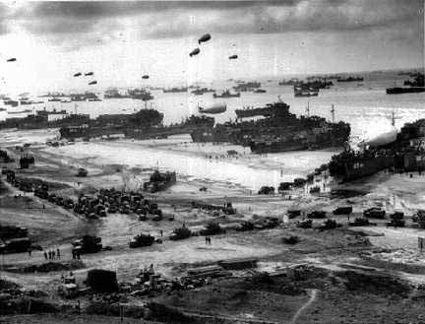
D-Day Landings
Notes:
http://www.google.com/imgres?um=1&hl=en&tbo=d&biw=1366&bih=610&tbm=isch&tbnid=xvBuU3znJmnzLM:&imgrefurl=http://www.rjgeib.com/heroes/draper/german-point-of-view.html&docid=__bCJ0XzNrdPlM&imgurl=http://www.rjgeib.com/heroes/draper/d-day-beach.jpg&w=432&h=329&ei=fjfDUL-1O5HssgbSmoDYAg&zoom=1&iact=rc&dur=578&sig=112516764352206821928&page=1&tbnh=136&tbnw=198&start=0&ndsp=18&ved=1t:429,r:2,s:0,i:156&tx=54&ty=87

Slide 7


Slide 8
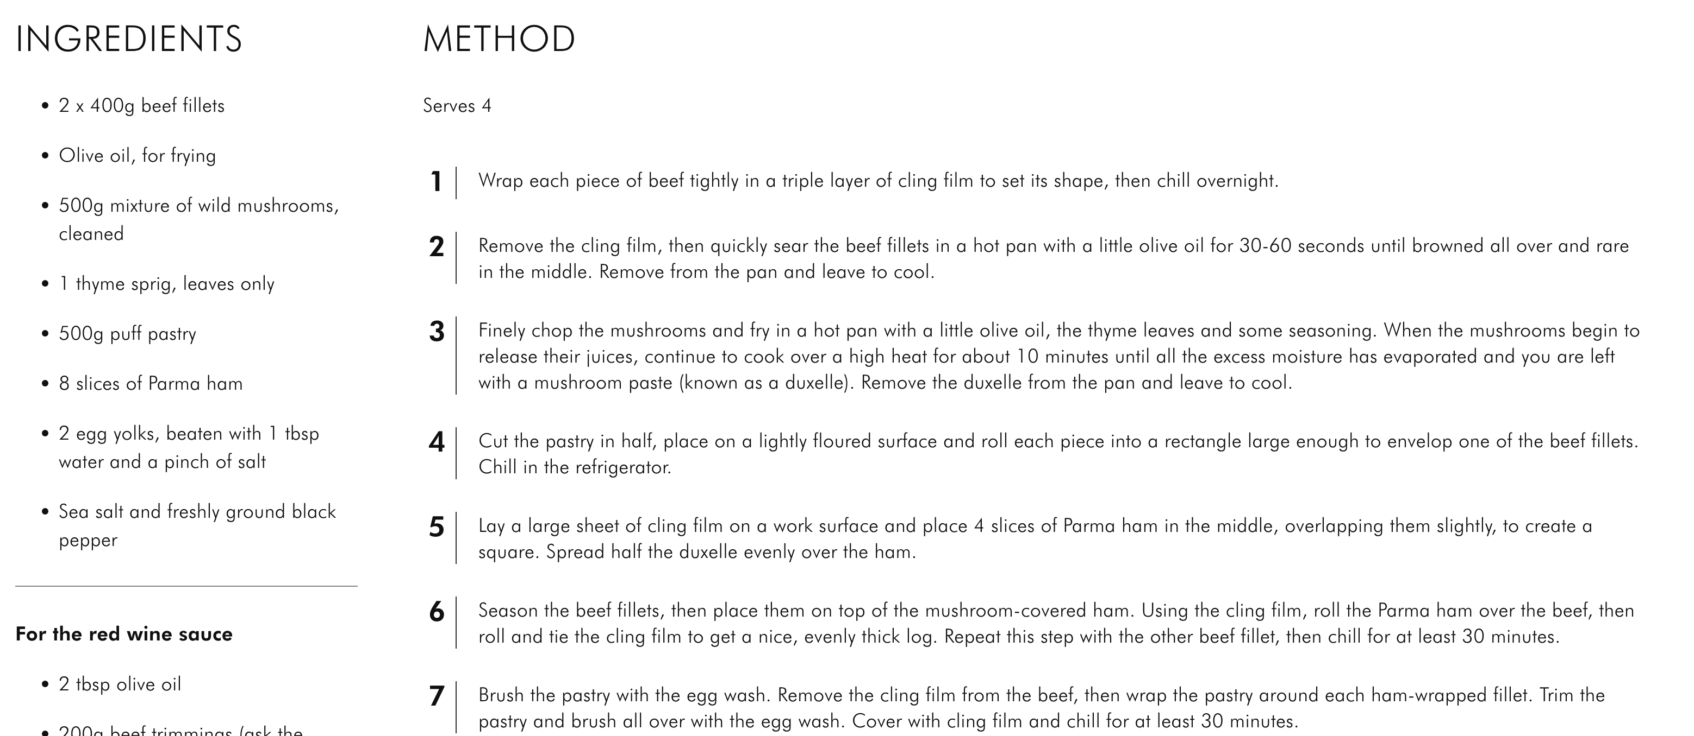



Slide 9




Digital Documention
Documentation created a new dimension of economic reality:
Bank accounts
Mortgages
Stocks and Options
Cryptocurrency
Credit Cards
Which are enduring social networks
Debts and credits become information entities analogous to digital artifacts

Slide 10




Digital Documention
Documentation created a new dimension of social reality:
Online profiles
Digital galleries
Tweets
Live feeds
Online forums
Which are also enduring social networks
Online presences becomes information entities analogous to digital artifacts

Slide 11

Social Reality
Standardized and digital document play a crucial role in supporting and progressing the modern social world
And much like a promise creates an obligation and a claim, so too documents create rights, obligations, responsibilities, etc.

Slide 12
Document Act Theory
Expanding speech act theory to document act theory has as its scope the social and institutional powers of documents, whether deontic, legal, etc.
Like speech act theory, such a theory concerns how to do things with documents:
Represent the ways things are
Prescribe others to do things
Commit ourselves to doing things
Change the world

Slide 13
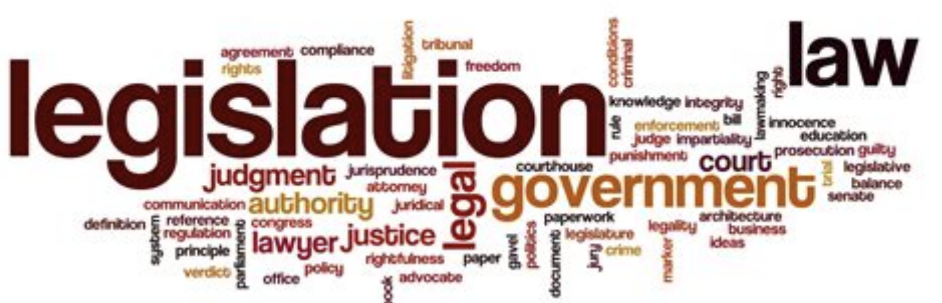
Directions of Fit for Documents Acts
Document act types can be distinguished in terms of their direction of fit:
World-to-Document: Plan created so world fits the plan, e.g. blueprint
Document-to-World: Report describes plan execution, e.g. evaluation
Standardization-of-Fit: Authority publishes rule, e.g. legislation

Slide 14
Importance of Documents
Documents and document systems are the mechanisms for creating the institutional orders of Western capitalism
It is a profoundly erroneous truism, repeated by all copy-books and by eminent people when they are making speeches, that we should cultivate the habit of thinking what we are doing. The precise opposite is the case. Civilization advances by extending the number of important operations which we can perform without thinking about them.
* de Soto, The Mystery of Capital: Why Capitalism Triumphs in the West and Fails Everywhere Else
* Whitehead, An Introduction to Mathematics

Slide 15
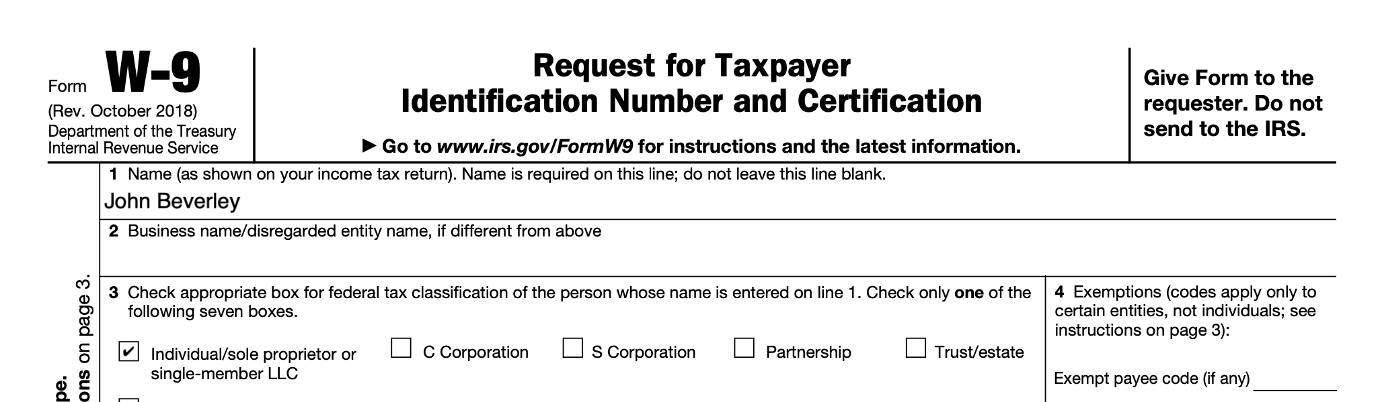
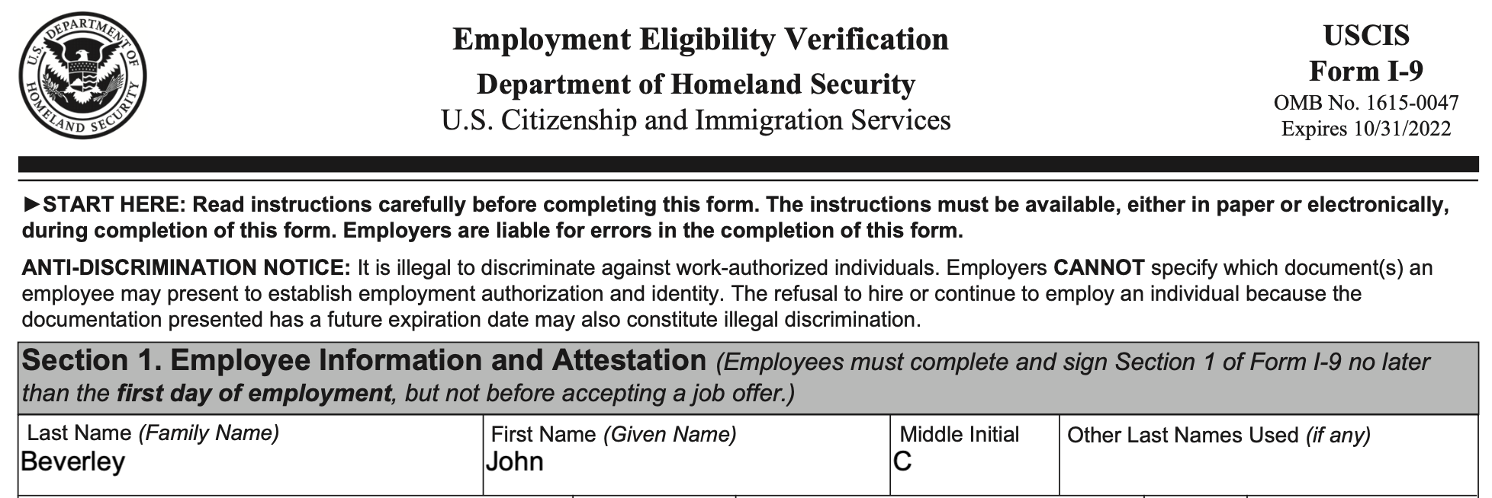
Standardized Documentation
Allow for standardized transactions, improved communication
Allow assets to be described in standard, stable, categories
Supports transition to robust registries

Slide 16
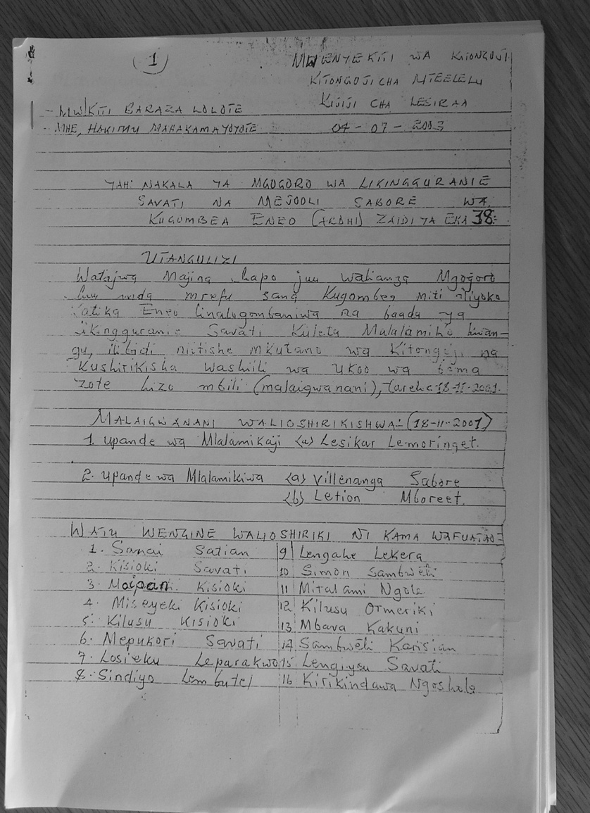
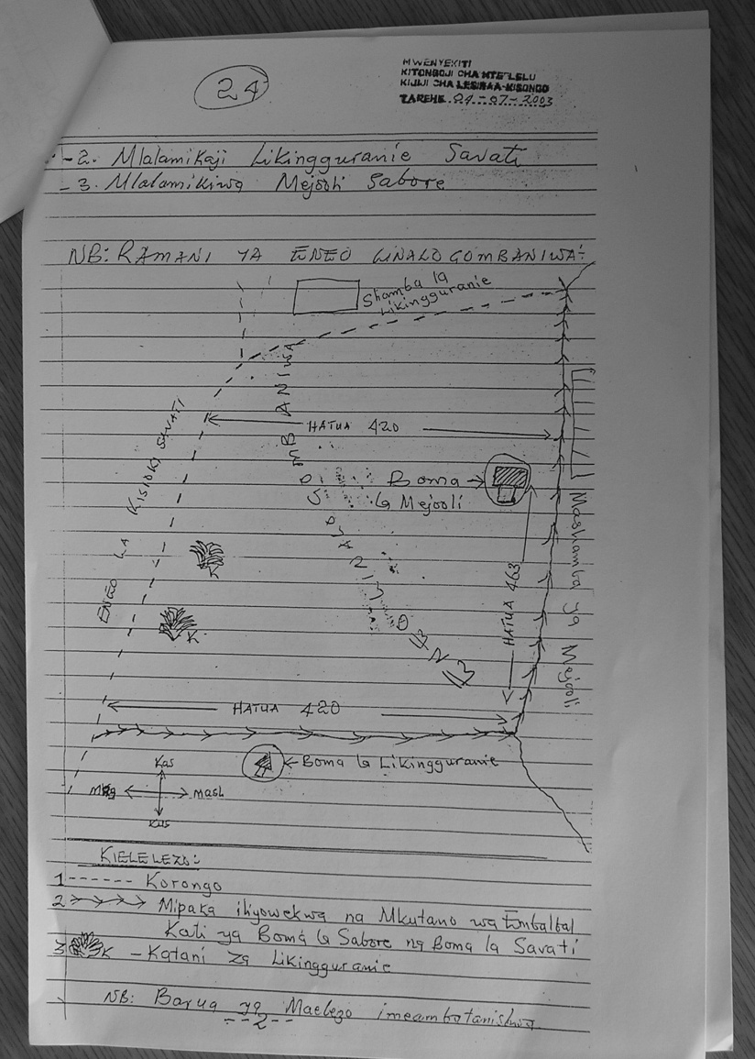
Property Rights
Property differs from a mere piece of land in that property is associated with documentation that creates and establishes rights which tie the owner to a physical asset
Documentation of property dispute
resolution over land in the Arusha area;
established property rights

Slide 17
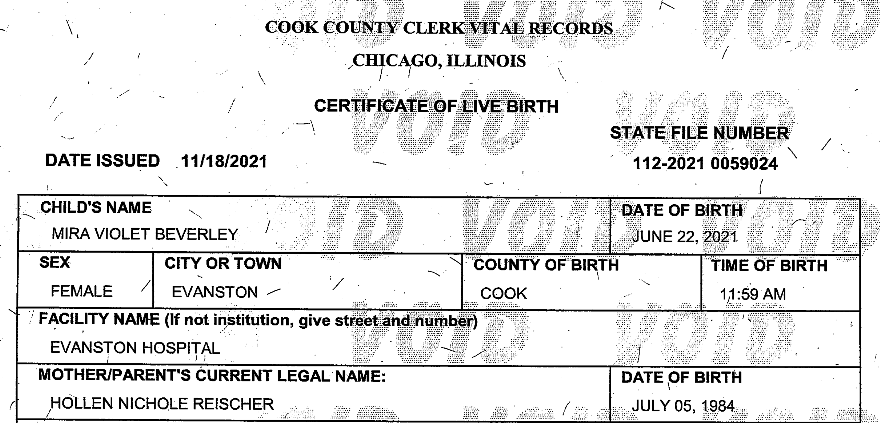
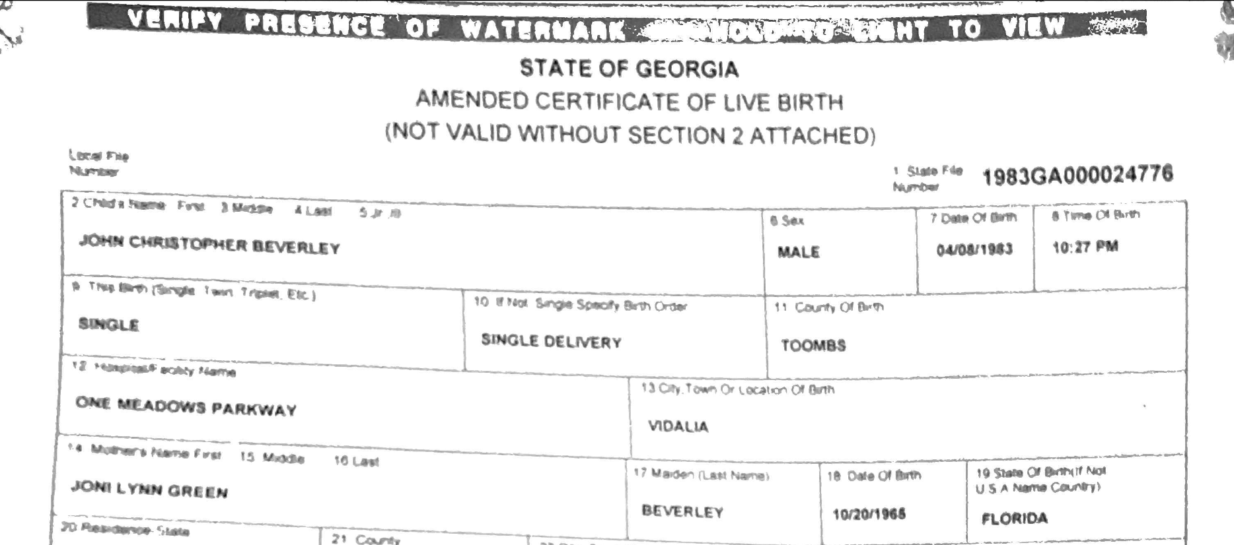
Vital Records
These documents create and bind
social and institutional reality
Vital records offices oversees curation of and ways in which records may be subjected to amendment

Slide 18
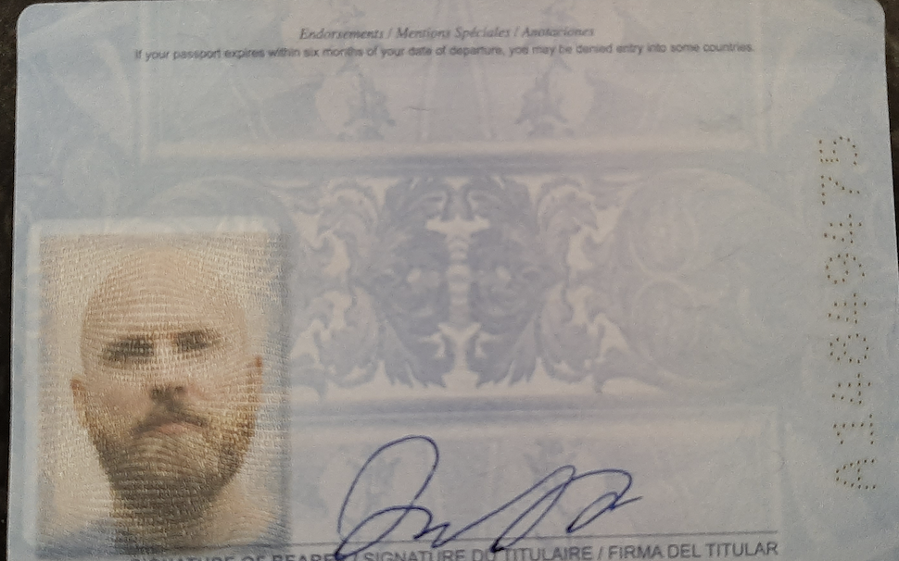
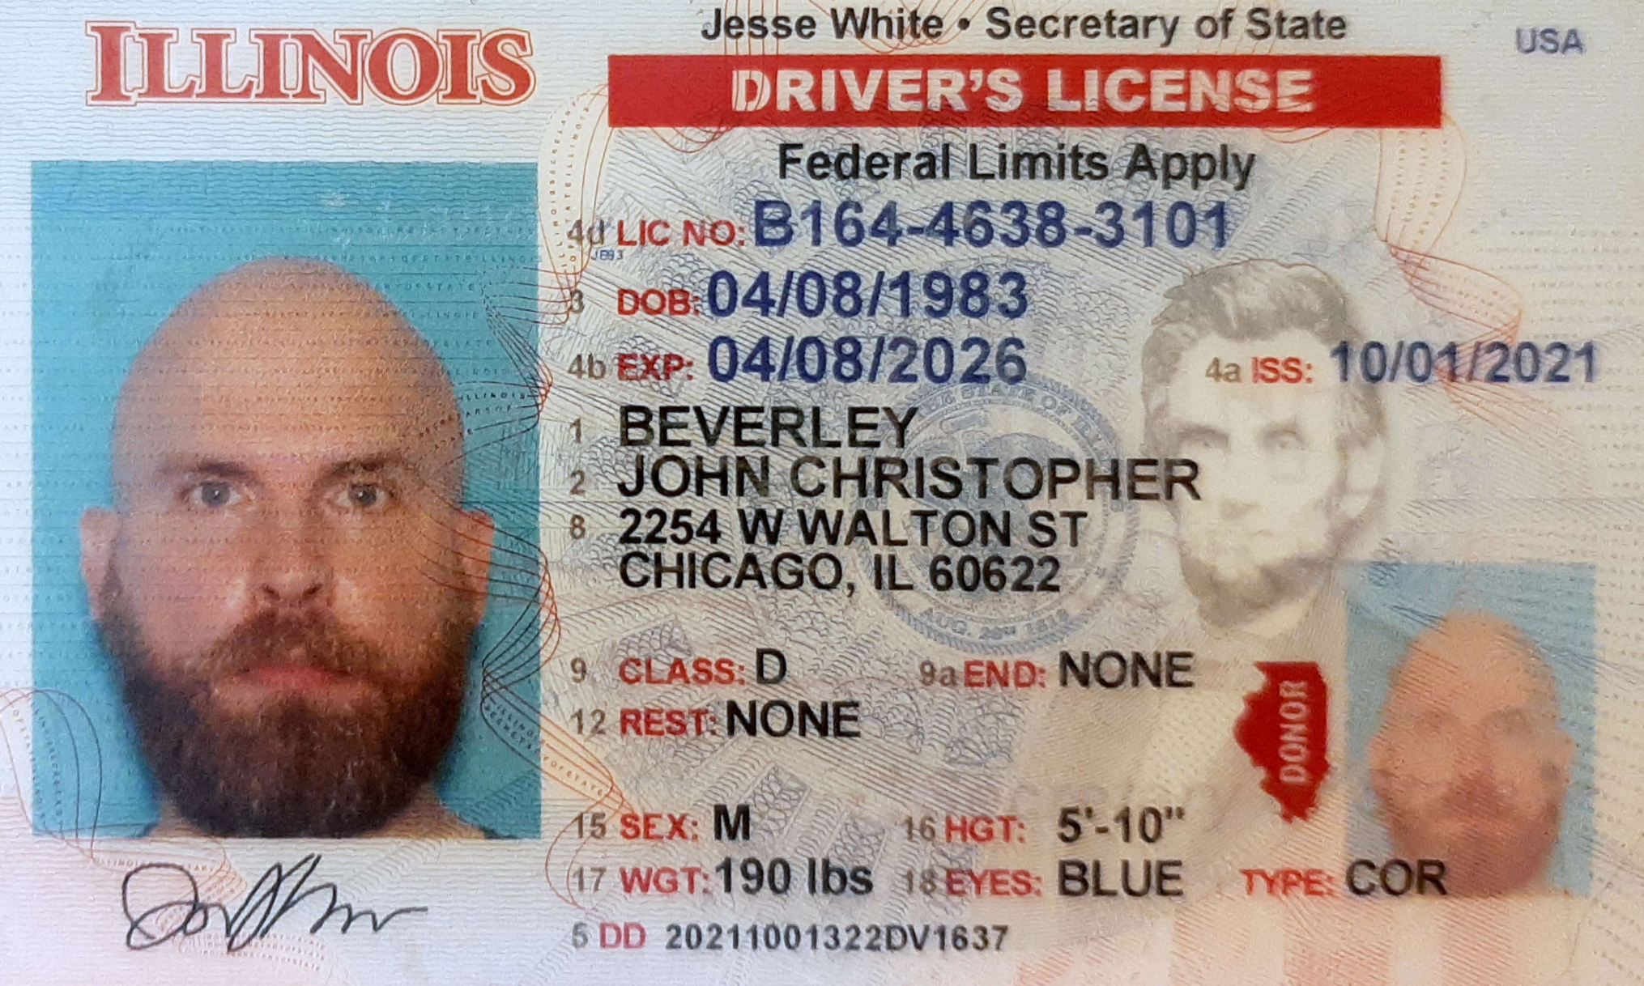

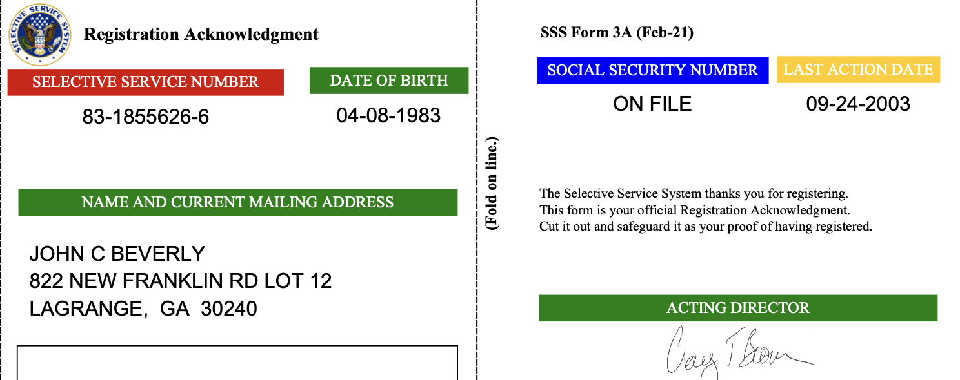
Credentials
Credentials are a type of standardized document which:
Serve as a status indicator
Are institutional objects
Credentials enable rights-holders to exercise rights, assuming the holder is able to display the appropriate documentation

Slide 19
BFO: Deontic Entities
An adequate account of deontic entities will require at a minumum ontological characterizations of:
Social dispositions, e.g. customs, languages, rituals, institutions, etc.
Speech acts, e.g. imperatives, interrogatives, etc. (see ARGO)
Mental functioning, e.g. beliefs, knowledge, hopes, etc. (see MFO)
Social acts, e.g. promising, praising, blaiming, etc.
Documents, e.g. credentials, authorized reports, etc. (see D-Acts)
Authorities, e.g. governments, institutions, etc. (see CCO)
green indicates developed work; blue indicates first steps; red indicates gap

Slide 20
Case Study: Marriage License
In the U.S., states impose eligibility requirements on individuals, e.g. individuals entering marriage must be able to consent and above a certain age.
States also impose eligibility requirements on the couple, e.g. one member of the union must be a U.S. citizen
Before 1967, several states prohibited interracial marriage; until 2015 several prohibited same-sex marriage.
Governments grant obligations to spouses - married partners bear financial responsibilities to one another - and privileges - married partners are not required to testify against one another in court.

Slide 21
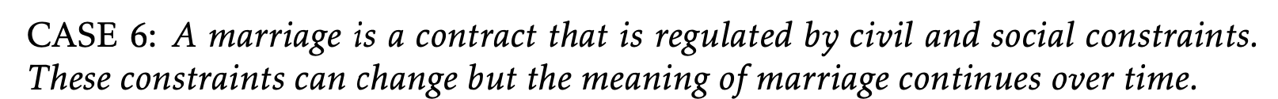
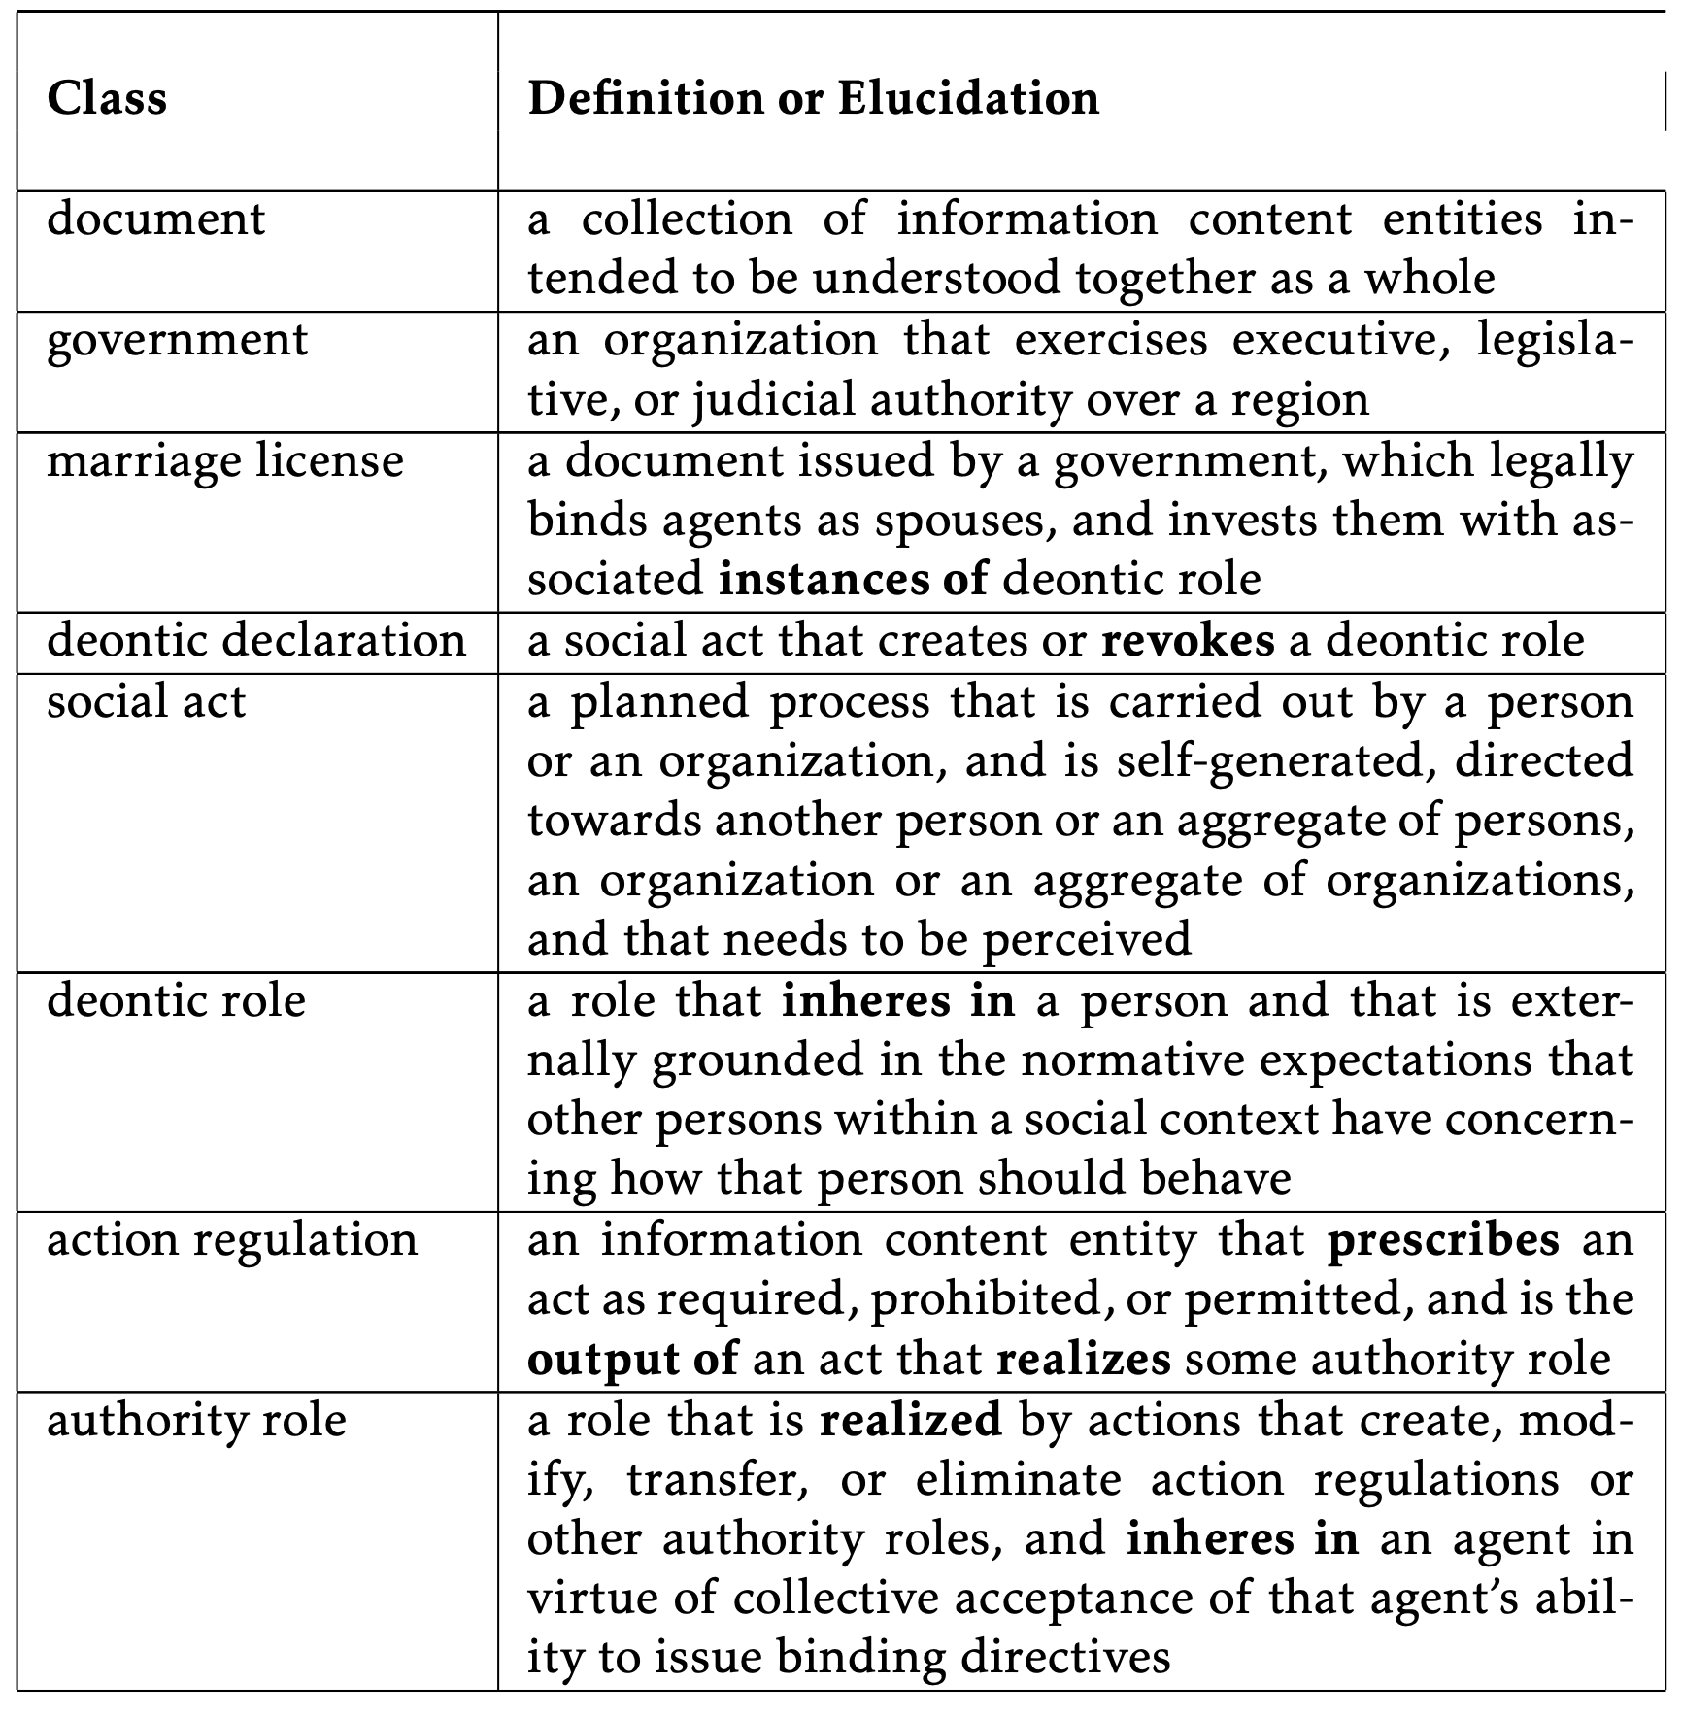
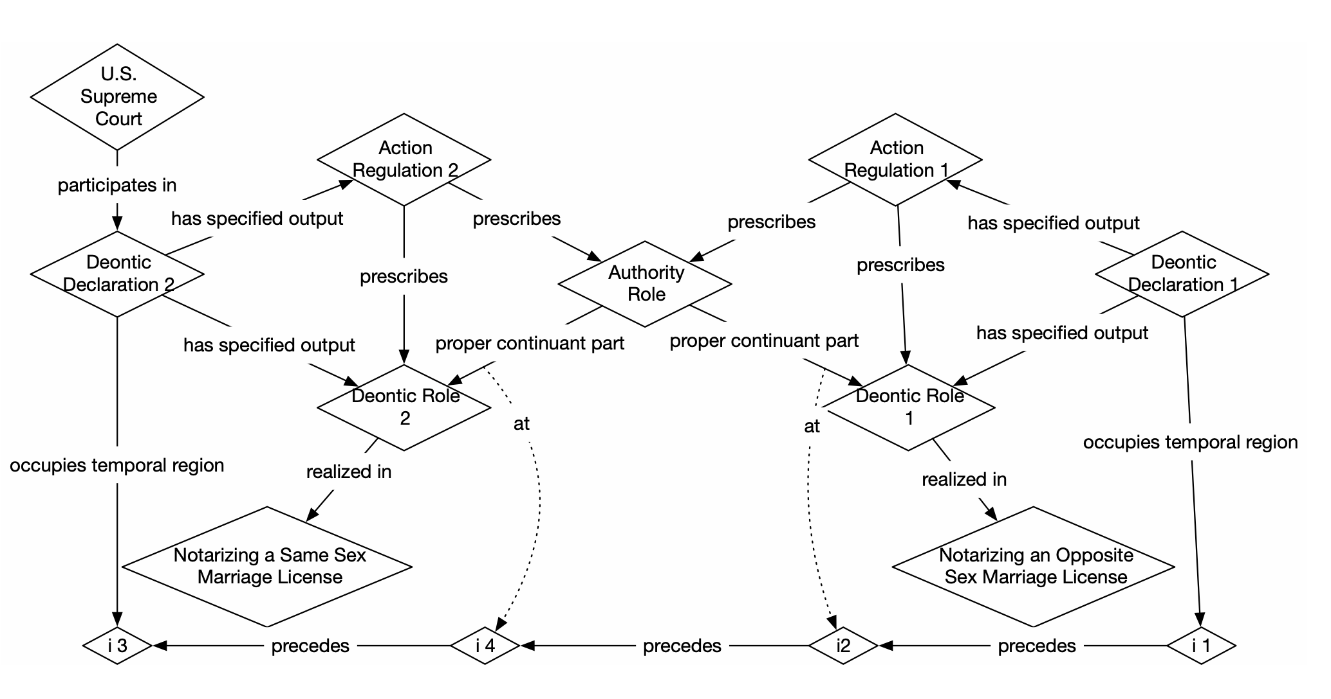

Slide 22
Readings
Aboutness: Towards Foundations for the Information Artifact Ontology
Document Acts
On Credentials
Ontology of Information Artifacts in the Intelligence Domain

